Slide 2
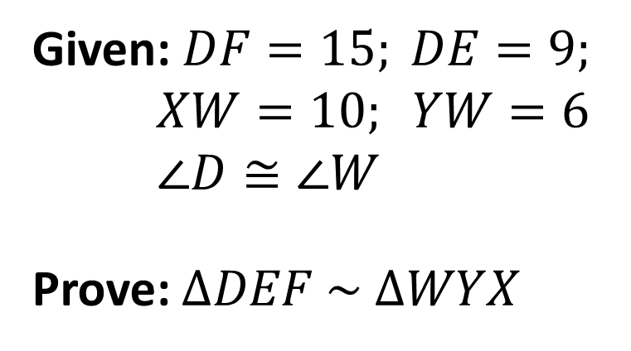
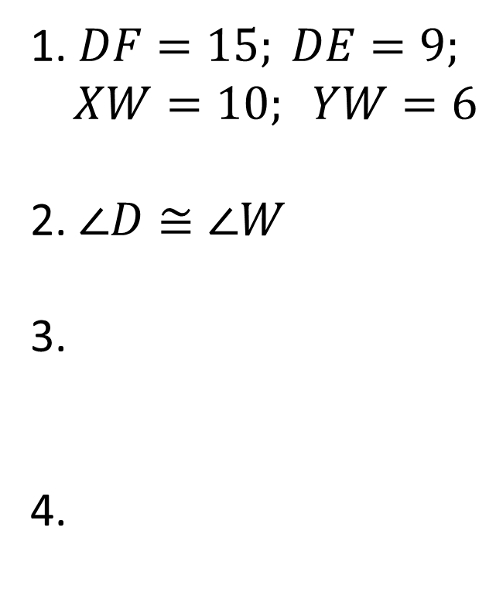
Warm Up – Monday, February 3, 2020
Given: $DF=15; DE=9;$
$XW=10; YW=6$
$∠D≅∠W$
Prove: $∆DEF \sim ∆WYX$
Statements
Reasons
1. $DF=15; DE=9;$
$XW=10; YW=6$
2. $∠D≅∠W$
3.
4.
Given
2. Given
3.
4.

Slide 3
White Boards…
State if the triangles in each pair are similar.
If so, state how you know they are similar and complete
the similarity statement.

Slide 4
Is $∆ABC \sim ∆ADE$ ?
Justify your reasoning... aka: show ALL your work

Slide 5
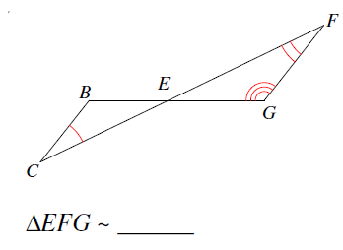
White Boards…
State if the triangles in each pair are similar.
If so, state how you know they are similar and complete
the similarity statement.

Slide 6
White Boards…
Determine if the pair of triangles are similar.
If they are, complete the similarity statement and the
method used to prove the similarity.
$$∆EBA\sim ∆____________$$

Slide 7
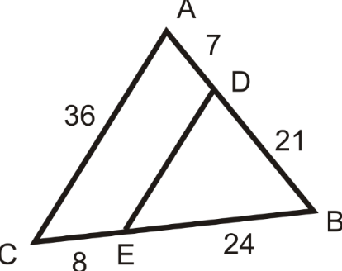
Is $∆ABC \sim ∆DBE$ ?
Justify your reasoning... aka: show ALL your work
27

Slide 8
Is $∆ABC \sim ∆ADE$ ?
Justify your reasoning... aka: show ALL your work

Slide 9
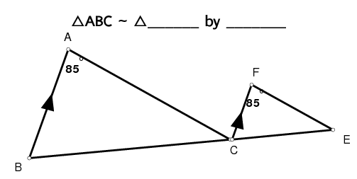
Determine if the pair of triangles are similar.
If they are, complete the similarity statement and the
method used to prove the similarity.

Slide 10
Determine whether the two triangles are similar.
If they are, show all work and write a similarity statement.
G

