Slide 1
Unfair Math Game
Interior Circle Relationships

Slide 2
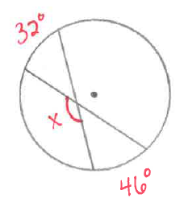
Notes:
141

Slide 3
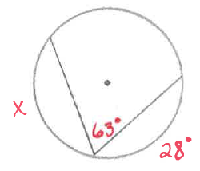
Notes:
206

Slide 4
How many points are required to construct a circle?
How many radii are contained in any given circle?
Notes:
2
infinite

Slide 5
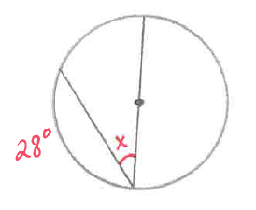
Notes:
76

Slide 6
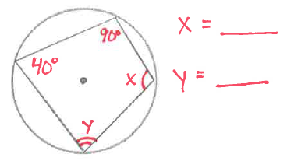
Notes:
x = 140
y = 90

Slide 7
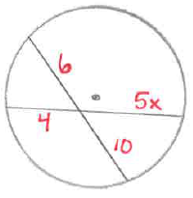
Notes:
x = 3

Slide 8
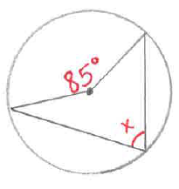
Notes:
42.5

Slide 9
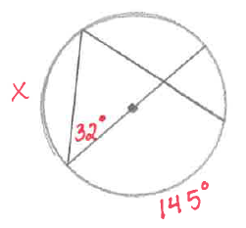
Notes:
116

Slide 10
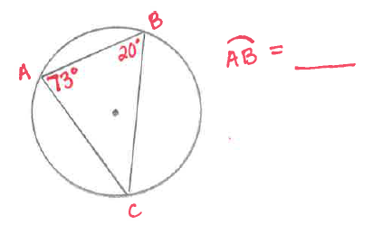
Notes:
174

Slide 11
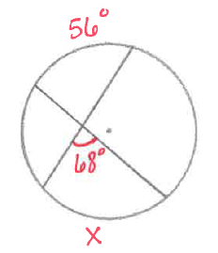
Notes:
80

Slide 12
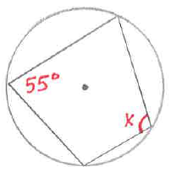
Notes:
125

Slide 13
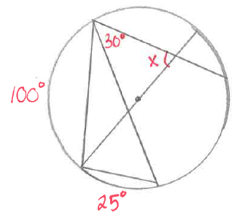
Notes:
50

