Slide 1
Test
Friday
Jeopardy
Circumscribed Circles
Inscribed Circles
Area of Sectors
Equations of Circles
Arc Length
100
100
100
100
100
200
200
200
200
200
300
300
300
300
300
400
400
400
400
400
500
500
500
500
500
Objective: To demonstrate and practice understanding on all Unit 6 material

Slide 2
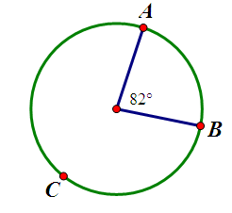
Circumscribed Circles 100
What is $m\hat{AB}$?
82°
Jeopardy Board
Answer
Notes:
82 degrees

Slide 3
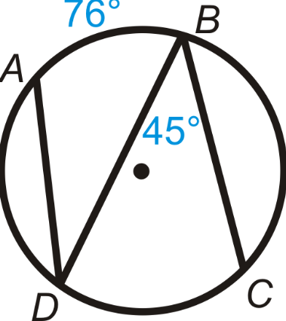
Circumscribed Circle 200
What is the $m∡ADB$?
What is the $m\hat{DC}$?
$$∡ADB=38°$$
$$\hat{DC}=90°$$
Answer
Jeopardy Board
Notes:
$$∡ADB=38°$$
$$\hat{DC}=90°$$

Slide 4
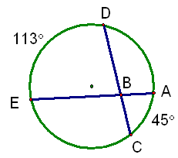
Circumscribed Circle 300
What is the $m∡DBE$?
Answer
Jeopardy Board
$$∡DBE=79°$$
Notes:
79 degrees

Slide 5
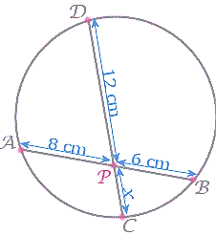
Circumscribed Circle 400
What is the length of x ?
x = 4
Jeopardy Board
Answer
Notes:
X = 4

Slide 6
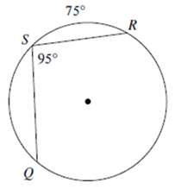
Circumscribed Circle 500
What is the $m\hat{QS}$ ?
$$m\hat{QS}=95°$$
Answer
Jeopardy Board
Notes:
95 degrees

Slide 7
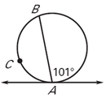
Inscribed Circle 100
What is the $m\hat{AB}$ ?
$$m\hat{AB}=202°$$
Answer
Jeopardy Board
Notes:
202 degrees

Slide 8
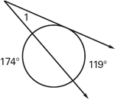
Inscribed Circle 200
What is the $m∠1$?
$$m∠1=26°$$
Answer
Jeopardy Board
Notes:
26 degrees

Slide 9
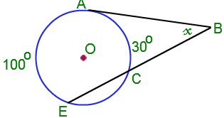
Inscribed Circle 300
What is the $m∠x$?
$$m∠x=35°$$
Answer
Jeopardy Board
Notes:
35 degrees

Slide 10
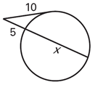
Inscribed Circle 400
What is the value of x?
4
x = 21
Answer
Jeopardy Board
Notes:
X = 21

Slide 11
Inscribed Circle 500
What is the value of x?
Jeopardy Board
x = 7
Answer
Notes:
X = 7

Slide 12
Area of a Sector 100
Convert 55 degrees to radians.
$$\frac{11 π}{36}$$
Answer
Jeopardy Board
Notes:
$$\frac{11 π}{36}$$

Slide 13
Area of a Sector 200
Convert $\frac{3 π}{10}$ to degrees
54$°$
Jeopardy Board
Answer
Notes:
54 degrees

Slide 14
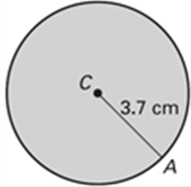
Area of a Sector 300
What is the area of the circle?
$$A=13.69π {cm}^{2}$$
$$A=43 {cm}^{2}$$
Answer
Jeopardy Board
Notes:
43 cm squared

Slide 15
Area of a Sector 400
What is the area of one of the sectors?
Round to the nearest hundredth.
7
38.48 ${units}^{2}$
Answer
Jeopardy Board
Notes:
38.48 units squared

Slide 16
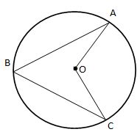
Area of a Sector 500
What is the area of sector AOC ?
5
70$°$
Answer
$$A=30.5 {units}^{2}$$
Jeopardy Board
Notes:
30.5 units squared

Slide 17
Arc Length
100
What’s the definition of a radian?
$$Radian=\frac{arc length}{radius}$$
Answer
Jeopardy Board
Notes:
Radian = arc length/radius

Slide 18
Arc Length
200
Given a sector with an arc length of 16 cm and a radius of 7 cm, what is the size of the angle in radians?
Answer
$$θ=2.28 rad$$
Jeopardy Board
Notes:
2.28 rad

Slide 19
Arc Length
300
Given a sector with a central angle of $\frac{π}{6}$ and a radius of 9 in, what is the length of its arc?
Answer
AL = 4.7 in
Jeopardy Board
Notes:
4.7 in

Slide 20
Arc Length
400
Given a sector with a central angle of 60$°$ and a radius of 7 cm, what is the length of its arc?
AL = 7.3 cm
Answer
Jeopardy Board
Notes:
7.3cm

Slide 21
Arc Length
500
Given a sector with a central angle of 74$°$ and an arc length of 92 cm. How long is the radius?
radius = 71.2 cm
Answer
Jeopardy Board
Notes:
71.2 cm

Slide 22
Equations of Circles 100
What is the equation of a circle whose center is (-3,4) and the radius is 7
$${(x+3)}^{2}+{(y−4)}^{2} =49$$
Jeopardy Board
Answer
Notes:
$${(x+3)}^{2}+{(y−4)}^{2} =49$$

Slide 23
Equation of Circles 200
What is the equation of the circle with center (-2,7) and the point (3,0) lies on the circle.
$${(x+2)}^{2}+{(y−7)}^{2} =74$$
Jeopardy Board
Answer
Notes:
$${(x+2)}^{2}+{(y−7)}^{2} =74$$

Slide 24
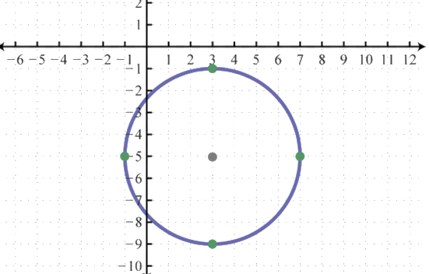
Equation of Circles 300
What is the equation of the circle on the coordinate plane?
$${(x−3)}^{2}+{(y+5)}^{2} =16$$
Answer
Jeopardy Board
Notes:
$${(x−3)}^{2}+{(y+5)}^{2} =16$$

Slide 25
Equation of Circles 400
What is the center and radius of the circle whose equation is:
$$x^{2}+y^{2}−16x+6y =20$$
Center: (8, -3)
Radius: $\sqrt{93}$
Answer
Jeopardy Board
Notes:
Center: (8, -3)
Radius: $\sqrt{93}$

Slide 26
Equation of Circles 500
Prove or Disprove that the point $(2, \sqrt{5} )$ is on the circle centered at the origin and contains the point (0, -3).
Yes, it does lie on the circle.
Answer
Jeopardy Board
Notes:
Yes, it does lie on the circle.

