Slide 1
Quadratics
review
Objective: swbat solve quadratics using various algebraic methods and
identify various graph features of quadratic functions.

Slide 2
Simplify by combining like terms.
(6x² + 5x – 4) + (-5x² + x + 7)
x² + 6x + 3

Slide 3
Simplify by combining like terms.
(6x² + 5x – 4) - (-5x² + x + 7)
6x² + 5x – 4 + 5x² – x - 7
11x² + 4x – 11

Slide 4
Find the area of the rectangle shown below.
x + 2
x + 1
(x + 2) (x + 1)
x² + x + 2x + 2
x² + 3x + 2

Slide 5
Find the area of the rectangle shown below.
2x + 3
x + 2
(2x + 3) (x + 2)
2x² + 4x + 3x + 6
2x² + 7x + 6

Slide 6
Find the area of the shaded area in the figure below.
2x + 3
x + 3
x + 2
x + 1
(2x + 3) (x + 2) – (x + 3) (x + 2)
(2x² + 7x + 6) - (x² + 3x + 2)
2x² + 7x + 6 – x² – 3x - 2
x² + 4x + 4

Slide 7
Chuck is solving the equation $x^{2 }+4x=7$ by completing the square. What number should be added to both sides of the equation to complete the square?
4
4
x² + 4x + ____ = 7 + ____

Slide 8
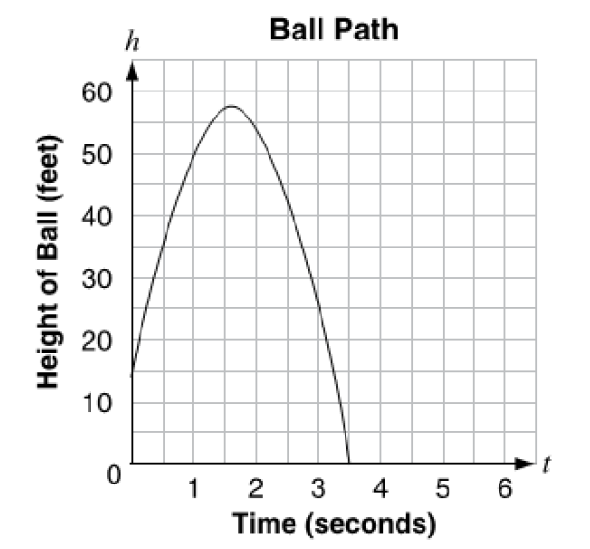
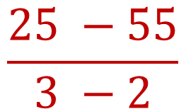
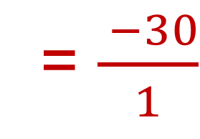
A ball is thrown up in the air. The graph shows its height, in feet, as a function of time in seconds.
What is the average rate of change from 2 seconds to 3 seconds?
(2, 55)
(3, 25)
$$\frac{25 −55}{3 −2}$$
= $\frac{ −30}{1}$
-30 feet per second

Slide 9
Suppose f(x) = 4x² - 6x – 9.
Find f(3).
4(3)² – 6(3) - 9
4(9) – 18 - 9
36 – 18 - 9
= 9

Slide 10
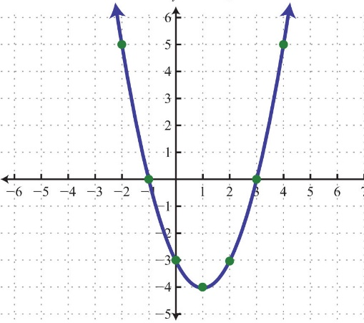
The figure shows a graph of the function f(x) in the x-y coordinate plane. A second function g(x) is defined by g(x) = 2x + 5. Which is the correct symbol to make this state true for f(2) _____ g(1).
= D. ≤
< E. ≥
>
f(2) = -3
g(1) = 2(1) + 5
(2, -3)
g(1) = 7

Slide 11
Factor the polynomial.
x² - 25
(x + 5) (x - 5)

Slide 12
Factor the polynomial.
x² - 121
(x + 11) (x - 11)

Slide 13
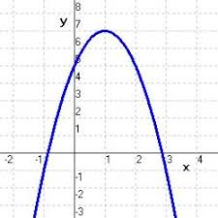
Determine the range of the function whose graph is shown below.
y ≤ 7

Slide 14
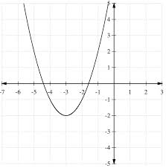
Determine the range of the function whose graph is shown below.
y ≥ -2

Slide 15
Find the product.
(5x – 4) (4x + 7)
20x² + 35x - 16x - 28
20x² + 9x - 28

Slide 16
Find the factors.
9x² + 30x - 11
-99
-3
33
9x² - 3x + 33x - 11
(9x² - 3x) + (33x – 11)
30
3x(3x – 1) + 11(3x – 1)
(3x – 1) (3x + 11)

Slide 17
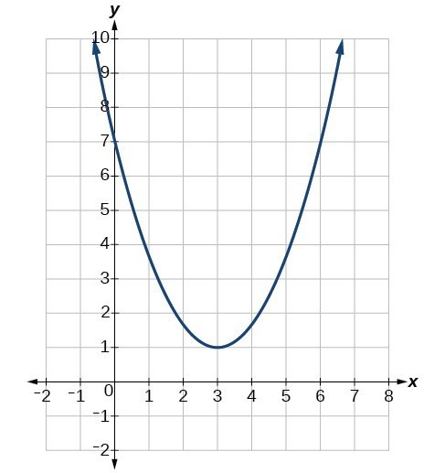
Drake graphed an equation on the coordinate plane below.
Based on the graph, which of the following points are solutions to the equation.
A. (0, 7) D. (3, 1)
B. (6, 4) E. (1, -2)
C. (1, 4) F. (6, 7)
Select all that apply.

Slide 18
Which equation below has the same solution set x² – 18x = -32?
(x – 9)² = 113
(x – 9)² = 49
(x – 18)² = -113
(x – 18)² = -49

Slide 19
Ann is solving the equation $x^{2 }−12x=5$ by completing the square. What number should be added to both sides of the equation to complete the square?
36
36
x² - 12x + ____ = 5 + ____

Slide 20
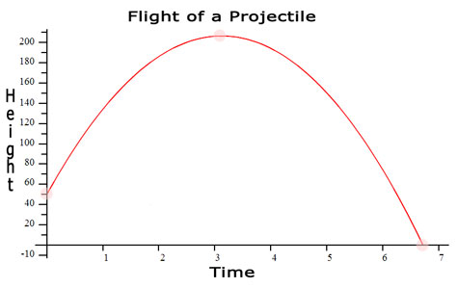
This graph models the height, y, in feet, of rocket being shoot in the air.
The rocket lands on the ground between 6 and 7 seconds.
What is the meaning of the x-intercept?

Slide 21
Solve for x:
2x² - 3x – 20 = 0
Factor:
(2x + 5) (x – 4)
Solve:
2x + 5 = 0 x – 4 = 0
x = -2.5 and x = 4

Slide 22
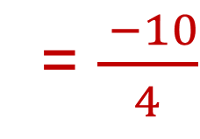
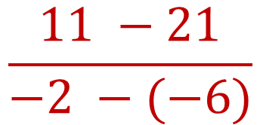
Determine the average rate of change form x = -6 to x = -2
C.
B. D.
$$\frac{−5}{2}$$
$$\frac{5}{2}$$
x | f(x)
-8 | 26
-6 | 21
-4 | 16
-2 | 11
0 | 6
$$\frac{−2}{7}$$
$$\frac{2}{7}$$
$$\frac{11 −21}{−2 −(−6)}$$
= $\frac{ −10}{4}$

Slide 23
A baton twirler throws a baton with an initial upward velocity is 23.7 meters per second (m/s) from 4 meters. The equation for the object’s height a s at time t seconds after launch is
s(t) = -4.9t² + 23.7t + 4 If the twirler doesn’t catch her baton, when does the object strike the ground?
2 seconds D. 5 seconds
3 seconds E. 6 seconds
4 seconds

Slide 24
A baton twirler throws a baton with an initial upward velocity is 23.7 meters per second (m/s) from 4 meters. The equation for the object’s height a s at time t seconds after launch is s(t) = -4.9t² + 23.7t + 4 Identify the average rate of change over the interval 1 second to 3 seconds
5.7 m/s C. -0.8 m/s
4.1 m/s D. -5.7 m/s

Slide 25
Determine the domain of the function whose graph is shown below.
x ≤ 4

Slide 26
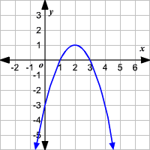
From the graph, use interval notation to identify the domain and range.
D: (-∞, ∞) R: (-∞, ∞)
D: (-∞, ∞) R: (-∞, 1)
D: (-1, ∞) R: (-∞, 5]
D: (-∞, ∞) R: (-∞, 1)
D: (-∞, ∞) R: (-∞, 1]

Slide 27
What questions do you have about quadratics?

