Slide 1
Unfair Math Game
Adding, Subtracting,
& Multiplying Polynomials
Unit 6 – Day 4

Slide 2
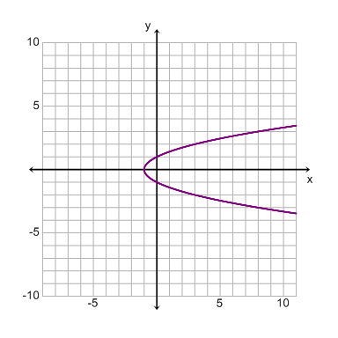
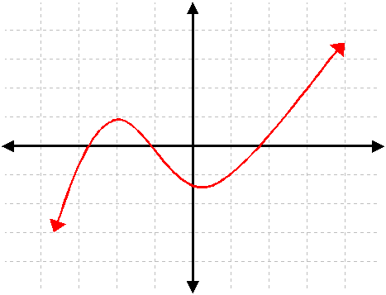
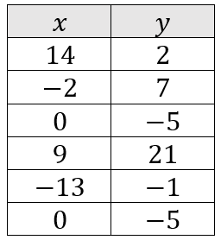
Warm Up: 1-16-17
Determine if the scenario is a function. Explain.
1.
2.
3.

Slide 3
#1
Simplify the expression:
$$\left(5x^{2}+7x\right)+\frac{2}{5}(−10x^{2}+5x−15)$$

Slide 4
#2
Simplify the expression:
$$\left(4x^{2}−2x+3\right)−3(x^{2}+4x−1)$$

Slide 5
#3
Simplify the expression:
$$\left(4x+6\right)(2x^{2}+8x−1)$$

Slide 6
#4
Simplify the expression:
$$\frac{1}{4}\left(12x^{2}−8x\right)−(3x^{2}−4x+8)$$

Slide 7
#5
Simplify the expression:
$$\left(−7x−5\right)(4x+2)$$

Slide 8
#6
Simplify the expression:
$$−1\left(x^{2}+4x−5\right)+(3x^{2}−12)$$

Slide 9
#7
Simplify the expression:
$$−2x\left(x^{2}−4x+13\right)$$

Slide 10
#8
Simplify the expression:
$$\left(x−10\right)(x+10)$$

