Slide 1
The Unfair Math Game
Standard form.
Vertex form.
NO Desmos!

Slide 2
1.
What is the STANDARD FORM equation for a quadratic function?
$$y=Ax^{2}+Bx+C$$

Slide 3
2.
What is the VERTEX FORM equation for a quadratic function?
$$y=a{\left(x−h\right)}^{2}+k$$

Slide 4
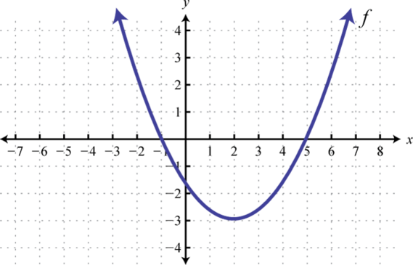
3.
Where are the roots?
$$(−1, 0)$$
$$(5, 0)$$

Slide 5
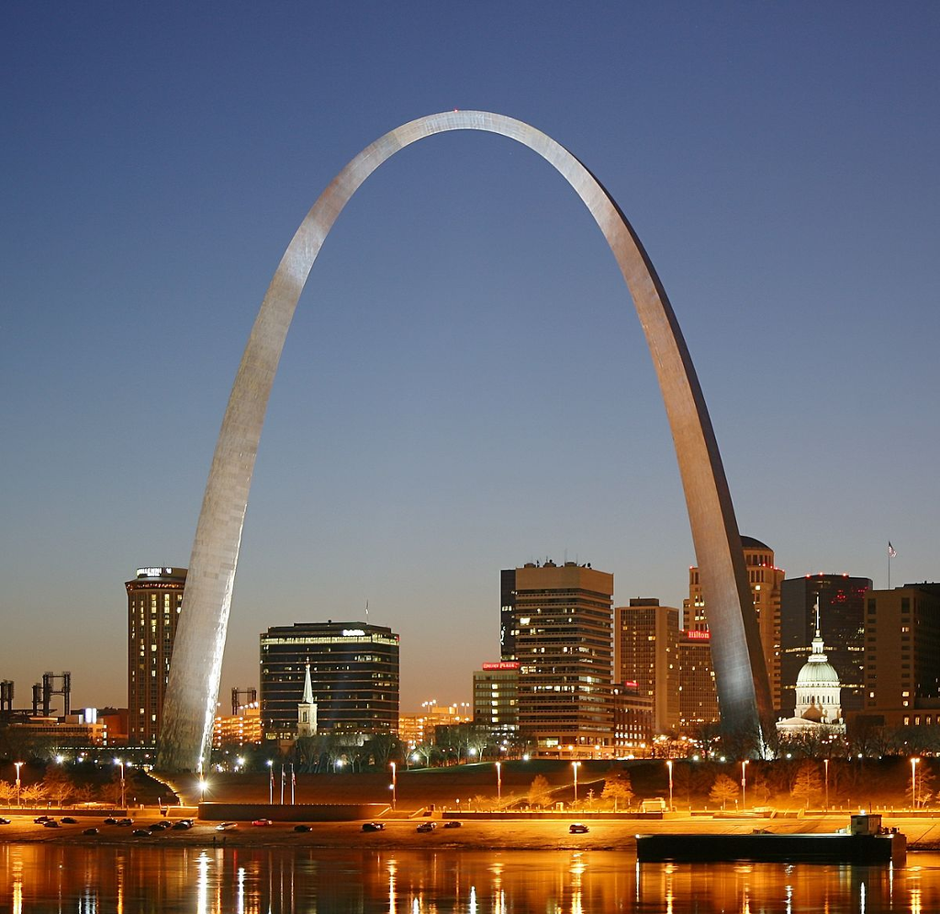
4.
$$g\left(x\right)={(x−6)}^{2}+7$$
1. Where is the vertex?
Name the axis of symmetry.
$$(6, 7)$$
$$x=6$$
St. Louis Arc, Missouri

Slide 6
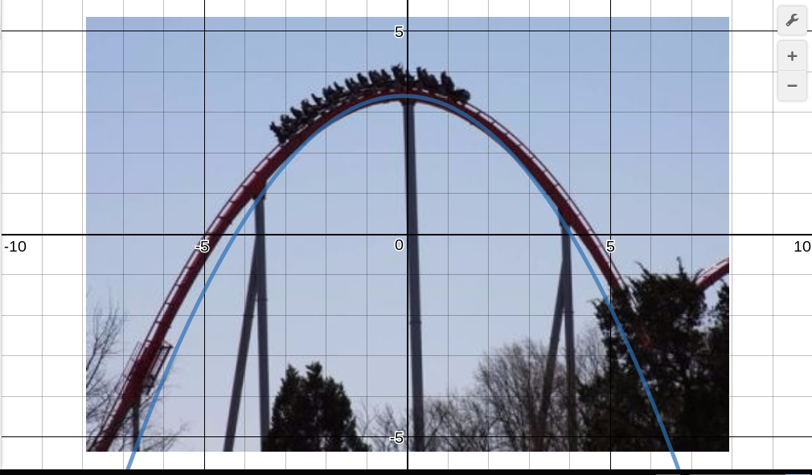
5.
Write an equation in vertex form…
has a vertex at $(−7, 4)$ and has been reflected.
$$y=−{\left(x+7\right)}^{2}+4$$

Slide 7
6.
$$y=−2x^{2}−4x+13$$
1. Where is the $y−$intercept?
Name the axis of symmetry.
Does the graph of open or has it been reflected?
$$(0, 13)$$
$$x=−1$$
Reflection

Slide 8
7.
$$f\left(x\right)={3x}^{2}+24x+10$$
1. Name the axis of symmetry.
Where is the vertex?
Is there a max or min?
$$x=−4$$
$$(−4, −38)$$
Minimum

Slide 9
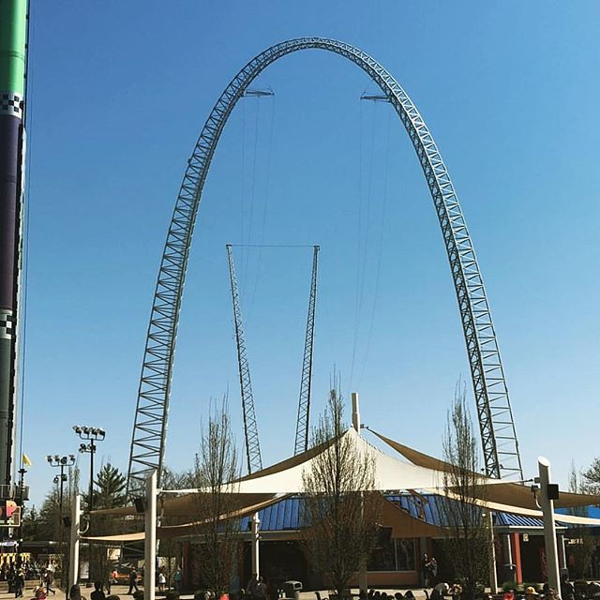
8.
$$d\left(x\right)={−x}^{2}−18$$
1. Where is the vertex?
Name the axis of symmetry.
Is there a max or min?
$$(0, −18)$$
$$x=0$$
Maximum
Some Random Event

Slide 10
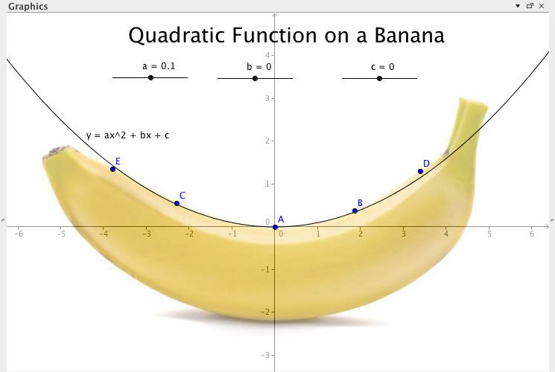
9.
Write an equation in vertex form…
has a vertex at $(9, 0)$.
$$y={\left(x−9\right)}^{2}$$

Slide 11
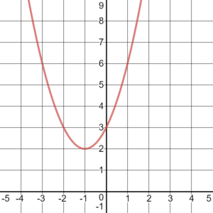
10.
Identify the roots.
No Roots/ $x−$intercepts.

Slide 12
11.
What is the average rate of change from 2 days to 8 days?
10 fruit flies per day.
(x) days | (y) Fruit Flies
0 | 2
2 | 12
4 | 30
8 | 72

